Slide 1

TEAM
NOCK-NOCK
Nathan Davids
Okuhle Charlieman
Cole Hanekom
Kiran Isaacs

Slide 2
CONTENT
01
04
VARIABLES & DATA TYPES
FUNCTIONS
02
05
OPERATORS
MODULES
03
06
CONTROL FLOW
REGULAR EXPRESSIONS

Slide 3


VARIABLES
Are names that represent values stored in memory
Example:
Name (variables) = Nathan (value)
DATA TYPES
Data types define the kind of values that variables can hold
Example:
String(str) = "any text"
Integer(int) = whole numbers
Float = decimal numbers

Slide 4
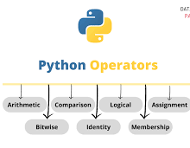
OPERATORS
Operators are used to test conditions and manipulating values.
Most statements contain expressions
An example of an expression is: 2 + 3
Operators provide the functionality to an expression and can be represented by symbols such as + or by keywords such as and
Require data to operate, and this data is known as an operand

Slide 5

CONTROLL FLOW
PYTHON FUNCTIONS
Sequential
Selection
Repitition
def function_name(parameter <,...>):
#suite
Ordinary
Procedure
Factory
INTRODUCTION TO MODUELS
REGULAR EXPRESSTIONS
math
time
tkinter
Parsing
Searching
Searching and replacing.
Splitting strings
Validation
Page 05 of 15

Slide 6
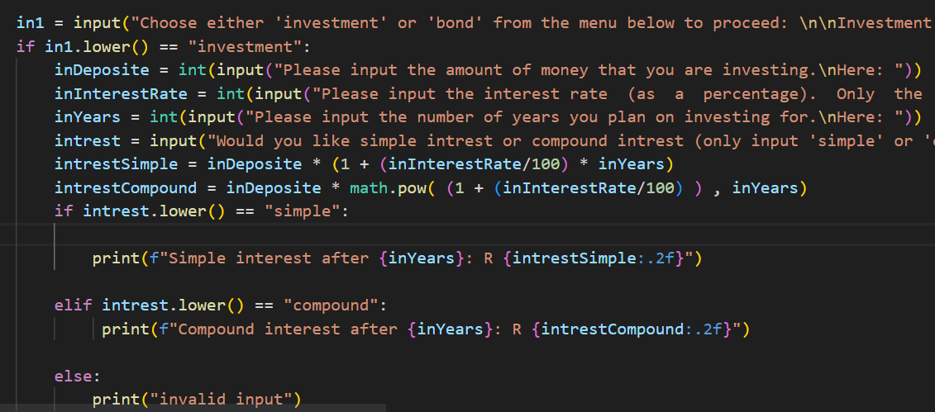
INVESTMENT CALCULATOR
SIMPLE INTEREST
A =P*(1+r*t)
COMPOUND INTEREST
A = P* math.pow((1+r),t)
‘r’ is the interest entered above divided by 100
‘P’ is the amount that the user deposits.
't’ is the number of years that the money is being invested for.
‘A’ is the total amount once the interest has been applied.

Slide 7
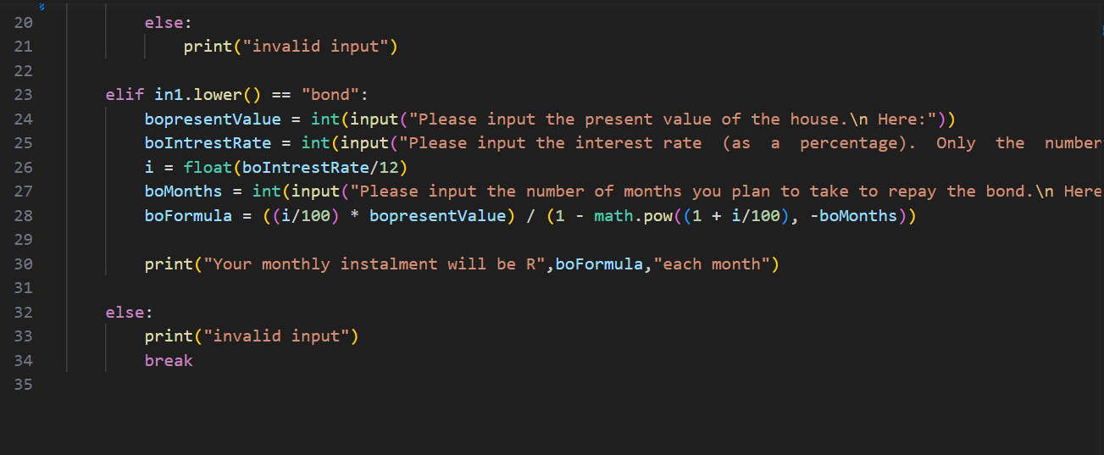
BOND CALCULATOR
BOND
x = (i.P)/(1 - (1+i)^(-n))
‘P’ is the present value of the house.
‘i’ is the monthly interest rate, calculated by dividing the annual interest rate by 12.
‘n’ is the number of months over which the bond will be repaid.

Slide 8

THANK YOU!
ANY QUESTIONS?

